Slide 1
TRANSIT SECURE SYSTEM

Slide 2
TECHNOCRATS
VAAGDEVI ENGINEERING COLLEGE
IEEE VEC STUDENT BRANCH
V. RAKSHITH
V. RAKESH
SYED SHARIQ SHARIEF
S. DAVID RAJU

Slide 3
PROBLEM STATEMENT:
BREAKTHROUGH IN VEHICLE SAFETY AND CONNECTIVITY

Slide 4
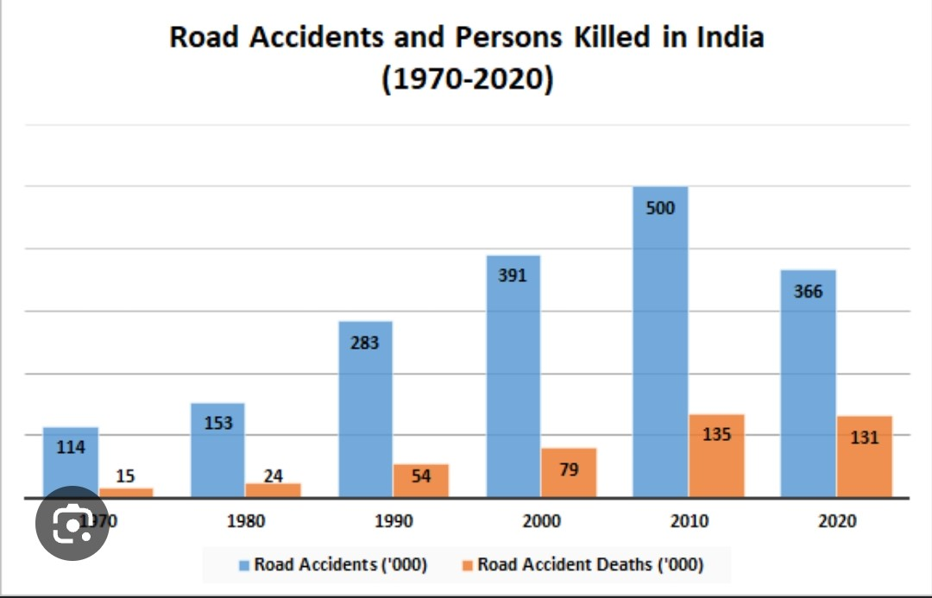
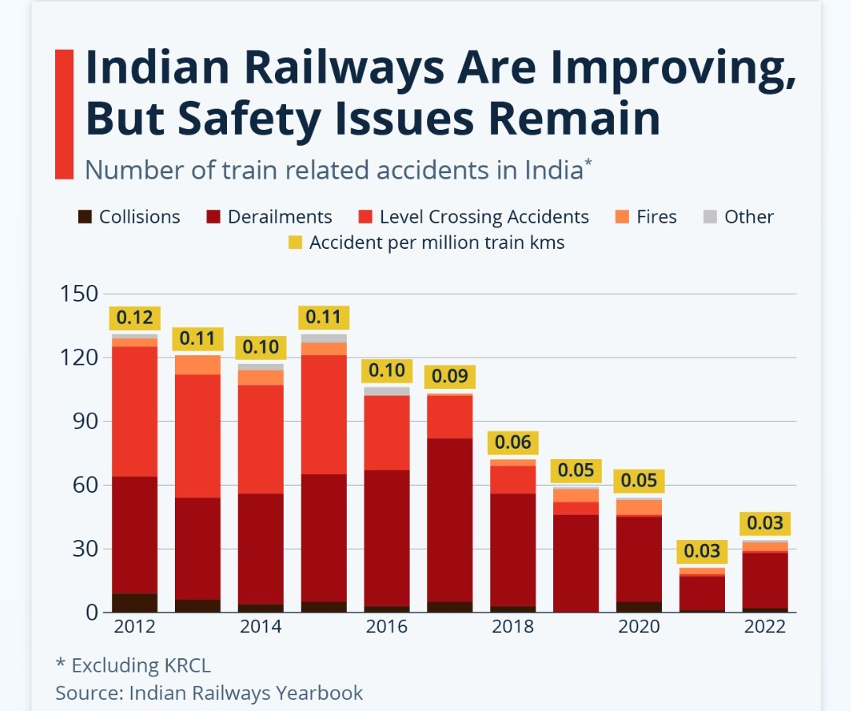
INTRODUCTION
During the year 2021,a total number of 4,12,432 road accidents have been reported in the country.
Claiming 1,53,972 lives and causing injuries to 3,84,448 persons.
In India 61 % of railway related fatalities are attributed to accidents at Unmanned Level of Crossings.
Nearly 2/3 of the total number of Level Crossing accidents occur at unmanned Level of Crossing and this proportion has been increasing ever since.

Slide 5
CAUSES
DUE TO LACK OF CAUTIOSNESS
2. LACK OF AWARENESS AMONG PASSENGERS
3. IMPROPER ALERTING & SECURITY SYSTEMS

Slide 6
SOLUTION
TRANSIT SECURE SYSTEM
To avoid the accidents and reduce the rate of death, we have come up with an technology Internet Of Things(IoT), where a vehicle can be controlled or stopped
when it encounters any obstacle.
We use Arduino which has dumped code of identifying objects and informs us the distance of the obstacle
If it reaches the specific range it alerts the vehicle and stop there by itself.
The sensors which we are using consumes less power.

Slide 7
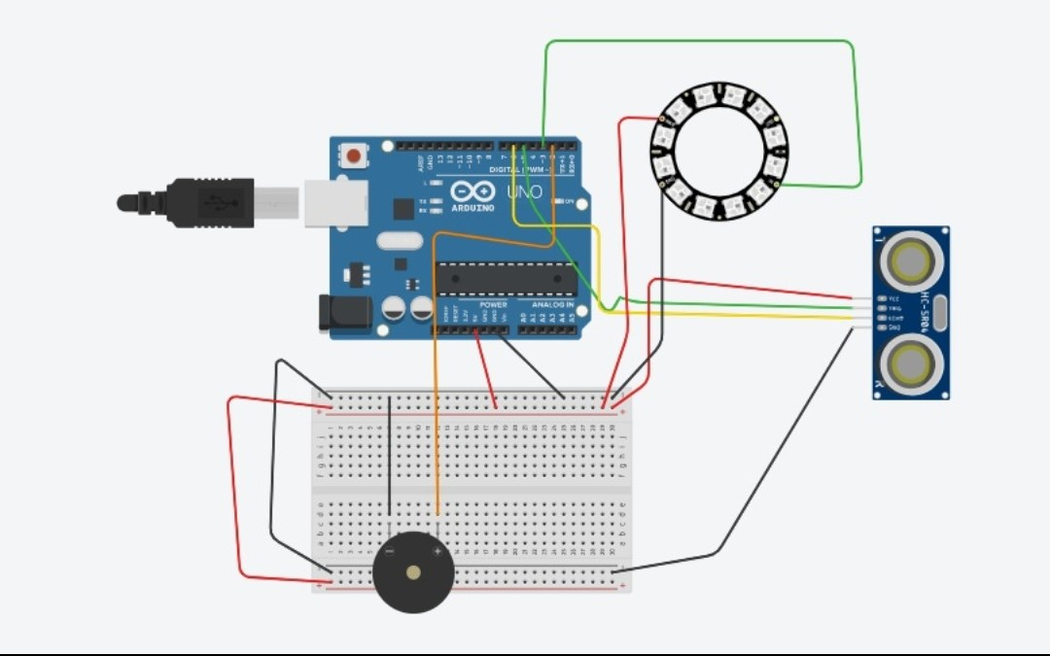

Slide 8
REQUIREMENTS
Arduino
Ultrasonic sensor
A battery – 9V
Jumper Cables
Breed board
Buzzer
Relay module

Slide 9
FUTURE SCOPE
IoT is transforming the transportation sector with the generation of intelligent transportation system(ITS)
It helps to optimize logistics and fleet management, goods and services, traffic management driver assistance etc to increase the safety and secure system.
It helps in automating railways, roadways, airways and marine vessels.

Slide 10
CONCLUSION
Through this technology we will be able to eradicate human error caused accidents on road, rail transportation.
THANK YOU

